Slide 1
Comparing New York and Toronto Neighborhoods
By Anton Anonymous
The XYZ Corp is looking forward to relocate part of its business operations from NY city to Toronto.
Among many business considerations is one voiced by HR department.
Business nature of XYZ Corp will require moving number of employees from NY city to Toronto.
HR is concerned about cultural and quality of life changes for these employees that will move to Toronto.
Information on cultural and lifestyle similarities between Toronto and New York is not readily available and is not easily measurable.

Slide 2
Data Sources
Foursquare API endpoints provide venue database for both Toronto and New York. This database has over sixty descriptive attributes that very well describe each venue. Borough and neighborhood data for both cities is readily available from many sources such as https://geo.nyu.edu/catalog/nyu_2451_34572 and https://en.wikipedia.org/wiki/List_of_postal_codes_in_Canada .
These sources will provide venue data and venue selection within city centre radius.

Slide 3
Feature selection
For lookup of neighborhoods of Toronto and New York : Borough, Neighborhood,
Latitude and Longitude were used.
Foursquare API venues endpoint provided venues: name , category,lattitude and
longitude.
Venue category was used to create feature set. This feature set is dependent on set of possible
values for venue category attribute , this can change in time and may be different for different
neighborhoods. Venue category attribute has hundreds of possible values.
Methodology
I used k-means clustering analysis on cities neighborhoods to determine similarities
between Toronto and New York neigborhoods in their venues.
For each neighborhood I derived new feature - mean of venue category for that
neighborhood. Geolocator package will be used to locate Toronto and New York boroughs
and neighborhoods. This information will be used in turn to select venues for each neighborhood.
The aggregated information on all venues in the neighborhood (for both cities) will be used in
k-means clustering analysis.
I expect that if clusters derived from this analysis contain proportional number of neighborhoods
from both cities it will be safe to claim that neighborhoods in both cities are quite similar with
respect to their venues.

Slide 4
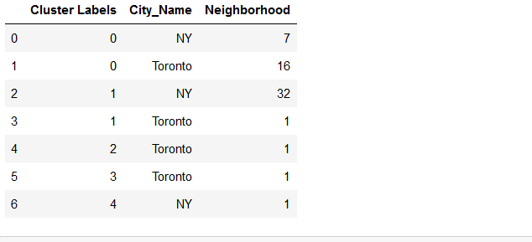
Results
Neighborhoods were grouped to 5 clusters.
2 clusters were unique for Toronto and 1 for New York.
These contained together only 3 neighborhoods of 59 in both cities.
HR is concerned about relocating its employees from New York to Toronto.
One of the aspects of possible relocation to consider is if living and lifestyle of both
these cities is similar. By analyzing neighborhood venues for both cities I found out
that in this aspect these cities are quite similar and HR should not be overly concerned
about differences.

Slide 5
Conclusion
Both New York and Toronto seem to be quite similar to live in. There are three neigborhoods that stand out, further analysis of these may be performed if necessary. To perform deeper analysis other sources of data on cost of living, education , healthcare will have to be used.

